Slide 1
Data Analysis in RUby (DaRU)
By Shekhar Prasad Rajak (@shekharrajak)

Slide 2
What is Daru ?
A Ruby gem
Analysing, manipulating and visualizing of data
Open source written mostly in RUby
Installation : gem install daru
Notes:
Daru (Data Analysis in RUby) is a library for analysis, manipulation and visualization of data. Daru works seamlessly accross interpreters and leverages interpreter-specific optimizations whenever they are available. It is the default data storage gem for all the statsample gems (glm, timeseries, etc.) and can be used with many others like mixed_models, gnuplotrb, nyaplot and iruby.

Slide 3
Robust
Powerful indexing support for storage and access of data.
Statistics and moving statistics functions.
Support time series.
Arel-like syntax for querying data.
Easily visualize data
Supports operations with missing data.

Slide 4
Friendly
Builds on top of existing Ruby data structures, so works with all interpreters.
Leverages specific interpreters resources whenever possible.
Integrates with other Ruby libraries.
Statistics - statsample, statsample_glm, statsample-timeseries, mixed-models
Visualization - Nyaplot, GnuplotRB
C level storage - NMatrix, rb-gsl

Slide 5
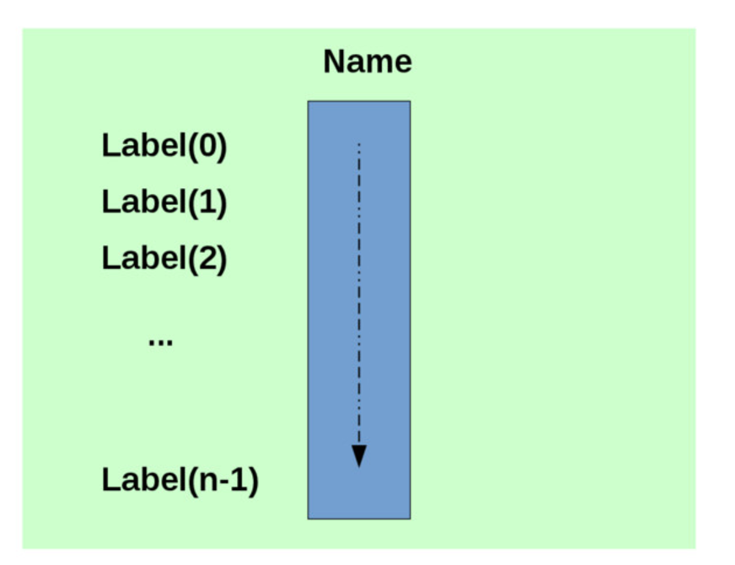
Daru::Vector
Heterogenous Array , that can be indexed on any Ruby object
Notes:
You can have a heterogenous array, which means a mixture of data types, like so:
var mix = [42, true, "towel"];

Slide 6
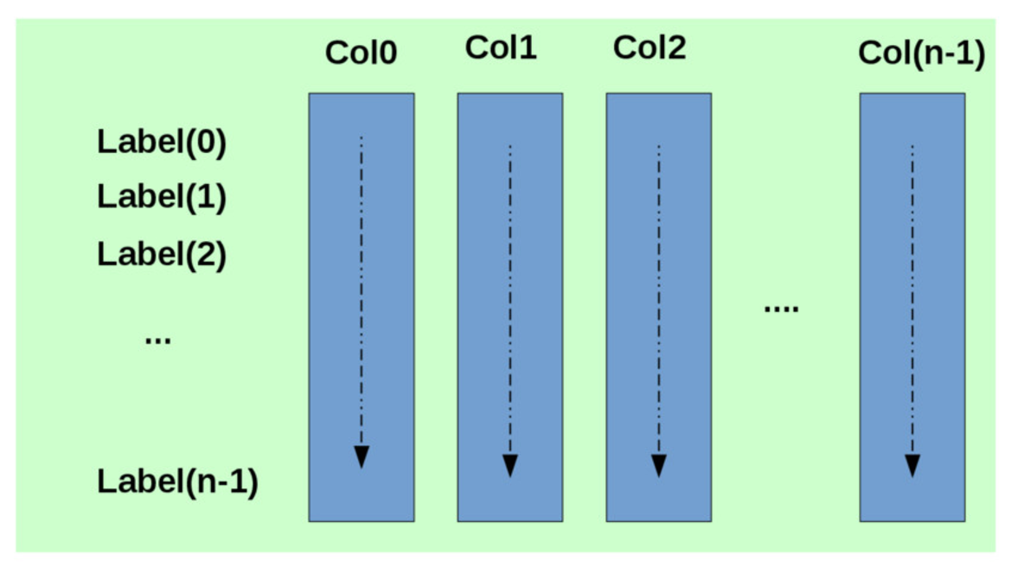
Daru::DataFrame
2D spreadsheet like data structure indexed by rows and column with ruby objects.

Slide 7
Examples
Notebook repo link

Slide 8
Blog post
Data Analysis in RUby: Basic data manipulation and plotting
Data Analysis in RUby: Splitting, sorting, aggregating data and data types
Finding and Combining data in daru

Slide 9

Thank You !
By Shekhar Prasad Rajak (@shekharrajak)

